Slide 1

VIRTUAL INTELLIGENCE DIRECTORATE
OMNIA VINCENT SAPIENTIA
Notian Navy
INTREP VID-OPAR-004
DISCLAIMER:
This is for multiplayer online gaming using the Digital Combat Systems simulation software published by Eagle Dynamics. The information is not in any way suitable for real world use or operations.
Version: 0.2
Published: 2024-12-29

Slide 2
INTRODUCTION
A
A
Aim:
This report intends to present information on Notian Navy structure and task organization while at sea.
Reference:
- INTREP VID B-003 Generic Navy Structure
Content:
Organization
Surface Action Group
Amphibious Task Group
Carrier Strike Group
B
B
C
C
D
D
E
E
F
F

Slide 3

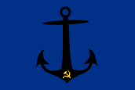
Organization
SRN Navy
10th Missile Ship Division
Pyotr Velikiy
Moskva
20th Anti-submarine Ship Division
40th Carrier Division
50th Supply Ship Division
Moskva
Moskva
30th Amphibious Division
Ropucha
Ropucha
Ropucha
Ropucha
Ropucha
211th Frigate Squadron
212th Frigate Squadron
Rezky
Neustrashimy
Kuznetzov
Rezky
Rezky
Rezky
Rezky
Neustrashimy
Neustrashimy
Neustrashimy
Neustrashimy
511th Tanker Squadron
Elnya
512th Cargo Squadron
Ivanov
Elnya
Elnya
Elnya
Ivanov
Ivanov
Ivanov
Ropucha
Rezky
Neustrashimy
60th Submarine Division
70th Coastal Defense Brigade
80th Amphibious Brigade
711th Coastal Defense Battalion
611th Attack Submarine Squadron
712th Coastal Defense Battalion
713th Coastal Defense Battalion
714th Coastal Defense Battalion
612th Strategic Submarine Squadron
Akula #1-#7
Delta IV #1-#11
A
A
B
B
C
C
D
D
E
E
F
F
Back

Slide 4
Doctrine: Surface Action Group (SAG)
A
A
B
B
C
C
FF
D
D
A doctrinal deployment of a basic SAG place a cruiser at the rear and two frigates upthreat to search for enemy submarines. The Cruisers role is to locate and neutralize enemy surface forces, and act as air defence for the SAG.
E
E
Threat direction
CG
F
F
FF
Legend:
CV: Carrier (Kuznetzov)
CG: Cruiser (Pyotr Viliky or Mokva)
FF: Frigate (Neustrashimy or Rezky)
LST: Landing Ship Tank (Ropucha)
Back

Slide 5
Doctrine: Amphibious Task Group (ATG)
A
A
B
B
C
C
FF
LST
D
D
A doctrinal deployment of a amphibious task group is to have the frigates upthreat to sanitize the area for enemy submarines. The amphibious ships will be organized close to the cruiser for protection.
As the ampibious ships conduct their assault toward the shore, the Cruiser will provide air defence for the landing operation, and the frigates will operate in anti-submarine operations further out from the shore.
E
E
Threat direction
LST
CG
F
F
LST
FF
Legend:
CV: Carrier (Kuznetzov)
CG: Cruiser (Pyotr Viliky or Mokva)
FF: Frigate (Neustrashimy or Rezky)
LST: Landing Ship Tank (Ropucha)
Back

Slide 6
Doctrine: Carrier Strike Group (CSG)
A
A
B
B
C
C
FF
FF
D
D
A doctrinal deployment of the Carrier Strike Group is to have two frigates upthreat to sanitize the area for enemy submarines. In addition two frigates are covering the rear of the carrier to avoid an ambush. The cruiser are positioned upthreat to act in a air defence and anti surface role to protect the carrier.
Offensive operations are conducted by the carrier based aircraft.
For increased protection, a SAG may be positioned 50nm closer to threat direction to keep the CSG safe.
E
E
Threat direction
CG
CV
F
F
FF
FF
Legend:
CV: Carrier (Kuznetzov)
CG: Cruiser (Pyotr Viliky or Mokva)
FF: Frigate (Neustrashimy or Rezky)
LST: Landing Ship Tank (Ropucha)
Back

Slide 7
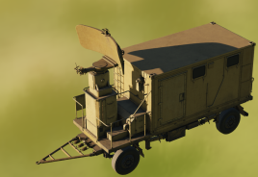
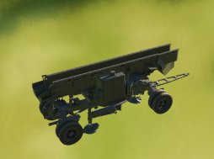
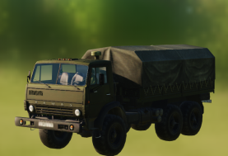
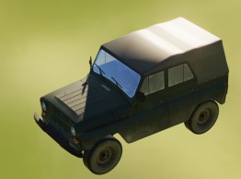
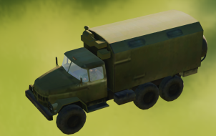
Coastal Defense Brigade
Threat direction
The Coastal Defense units are equipped with SS-N-2 Silkworm missiles that targets surface ships.
The Coastal Defense Brigade consist of 4 Coastal Defense Battalions, which again consist of 2 batteries per battalion.
Each Battalion consist of one search radar and two missile launchers. Each towed by a Kamaz 43101 Truck. In the battery there is a UAZ-469 Jeep and ZIL-131 truck for command and control.
The Coastal Defense units are used to keep enemy ships away from Notian territory.
Radar
Launcher
Launcher
C2
AShM Silkworm SR
AShM SS-N-2 Silkworm
Truck KAMAZ 43101
LUV UAZ-469 Jeep
Truck ZIL-131 (C2)
Back

Slide 8
Marine Infantry
A
A
B
B
C
C
FF
FF
D
D
A doctrinal deployment of the Carrier Strike Group is to have two frigates upthreat to sanitize the area for enemy submarines. In addition two frigates are covering the rear of the carrier to avoid an ambush. The cruiser are positioned upthreat to act in a air defence and anti surface role to protect the carrier.
Offensive operations are conducted by the carrier based aircraft.
For increased protection, a SAG may be positioned 50nm closer to threat direction to keep the CSG safe.
E
E
Threat direction
WIP
CG
CV
F
F
FF
FF
Legend:
CV: Carrier (Kuznetzov)
CG: Cruiser (Pyotr Viliky or Mokva)
FF: Frigate (Neustrashimy or Rezky)
LST: Landing Ship Tank (Ropucha)
Back

Slide 9
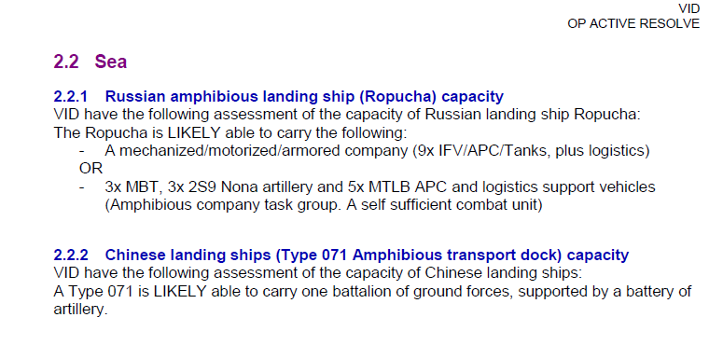
TTP: Amphibious assault
A
A
B
B
C
C
FF
FF
D
D
A doctrinal deployment of the Carrier Strike Group is to have two frigates upthreat to sanitize the area for enemy submarines. In addition two frigates are covering the rear of the carrier to avoid an ambush. The cruiser are positioned upthreat to act in a air defence and anti surface role to protect the carrier.
Offensive operations are conducted by the carrier based aircraft.
For increased protection, a SAG may be positioned 50nm closer to threat direction to keep the CSG safe.
E
E
Threat direction
WIP
CG
CV
F
F
FF
FF
Legend:
CV: Carrier (Kuznetzov)
CG: Cruiser (Pyotr Viliky or Mokva)
FF: Frigate (Neustrashimy or Rezky)
LST: Landing Ship Tank (Ropucha)
Back

